Slide 1
Digital Portfolio
STUDENT NAME: :T.KARTHIKA
REGISTER NO AND NMID: :24131061802522033 AND
58CA91F4E05A4028D8348CE07F661A5D
DEPARTMENT: :B.sc COMPUTER SCIENCE(II YEAR)
COLLEGE: COLLEGE/ UNIVERSITY. : SEREE RAGHAVENDRA ARTS AND SCIENCE
COLLEGE, KEEZHAMOONGILADI AFFILIATED
TO ANNAMALAI UNIVERSITY, CHIDAMBARAM

Slide 2
PROJECT TITLE :
DIGITAL PORTFOLIO :
This project is a simple online portfolio for Karthika T The website introduces Karthika, shows her skills (like Python, HTML, CSS,
JavaScript, Java, C, C++), displays her certificates, and mentions her interests in sports such as badminton and volleyball.
KEY SECTION :
1. Introduction and CV download
2. About Me (education and interests)
3. Skills displayed with icons
4. Certificates with details
5. Sports interests
6. Contact information (email, LinkedIn, GitHub)
This portfolio is useful to share her profile, achievements, and contact details with others in a modern and organized wa

Slide 3


AGENDA
Problem Statement
Project Overview
End Users
Tools and Technologies
Portfolio design and Layout
Features and Functionality
Results and Screenshots
Conclusion
Github Link
3/21/2024 Annual Review

Slide 4

PROBLEM STATEMENT:
Students often struggle to present their skills,
achievements, and projects in a professional manner.
Traditional resumes are static and
lack interactivity. A personal portfolio
website helps in showcasing technical
skills, certificates, and extracurricular
activities dynamically, increasing
opportunities for internships and jobs.

Slide 5

PROJECT OVERVIEW:
This project is a personal portfolio website developed
for Karthika T. It highlights education, skills,
certificates, extracurricular achievements,
and contact information in an interactive and
visually appealing design. The portfolio is fully
responsive and deployed on GitHub Pages for
public access.

Slide 6

WHO ARE THE END USERS?
Recruiters → To evaluate skills, certificates, and academic
achievements.
Faculty / College evaluators → For project assessment and
showcasing student achievements.
Peers and collaborators → To connect and collaborate on
projects.
General audience → To know about Karthika's journey and
capabilities.

Slide 7

TOOLS AND TECHNIQUES:
Frontend Framework: React.js
Styling: CSS, animations
Other Libraries: react-icons, typed.js, AOS animations
Version Control: Git & GitHub
Deployment: GitHub Pages
Design Tools: Canva / Figma for layout inspiration
7

Slide 8
POTFOLIO DESIGN AND LAYOUT
The portfolio follows a modern single-page scrolling layout with sections:
Home (Hero) → Animated introduction with glowing effects and profile photo.
About → Personal introduction, education details, and career goal.
Skills → Display of technical skills with logos and animations.
Certificates → Achievements displayed with pop-up view and download option.
Sports → Section highlighting extracurricular activities with images.
Contact → Direct links to email, GitHub, and LinkedIn.
Footer → Clean copyright and quick links.
‹#›

Slide 9
FEATURES AND FUNCTIONALITY
1. Animated typing effect for introduction.
2. Floating glowing decorations for modern design.
3. Profile photo with animated circular border.
4. Certificates displayed as cards with pop-up view and
download option.
5. Sports achievements showcased with images and descriptions.
6. Smooth scroll navigation with navbar.
7. Fully responsive (works on desktop and mobile).

Slide 10
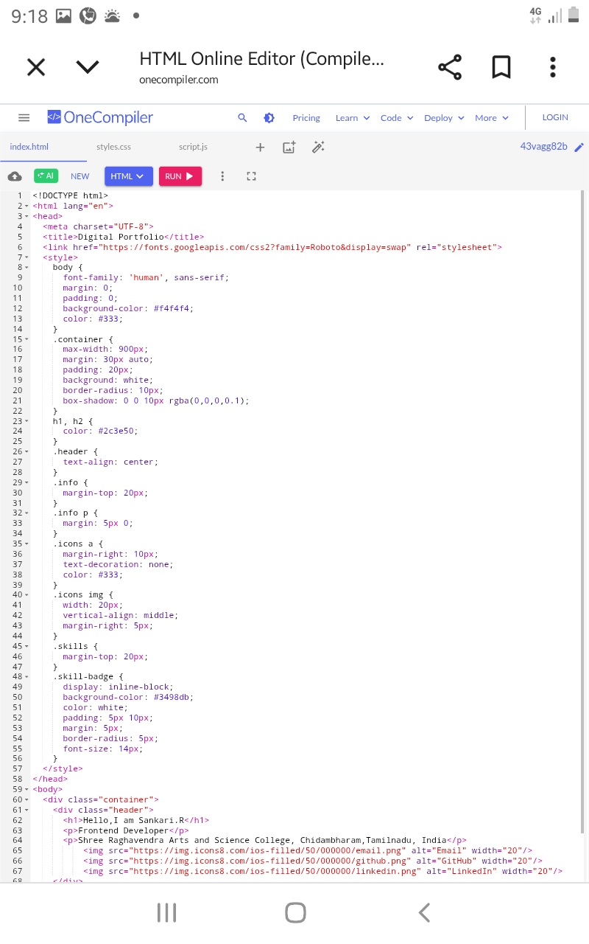
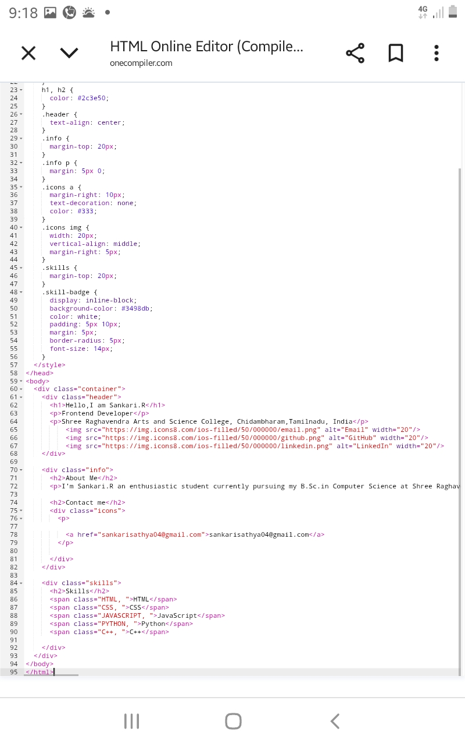
RESULTS AND SCREENSHOTS(HTML)

Slide 11
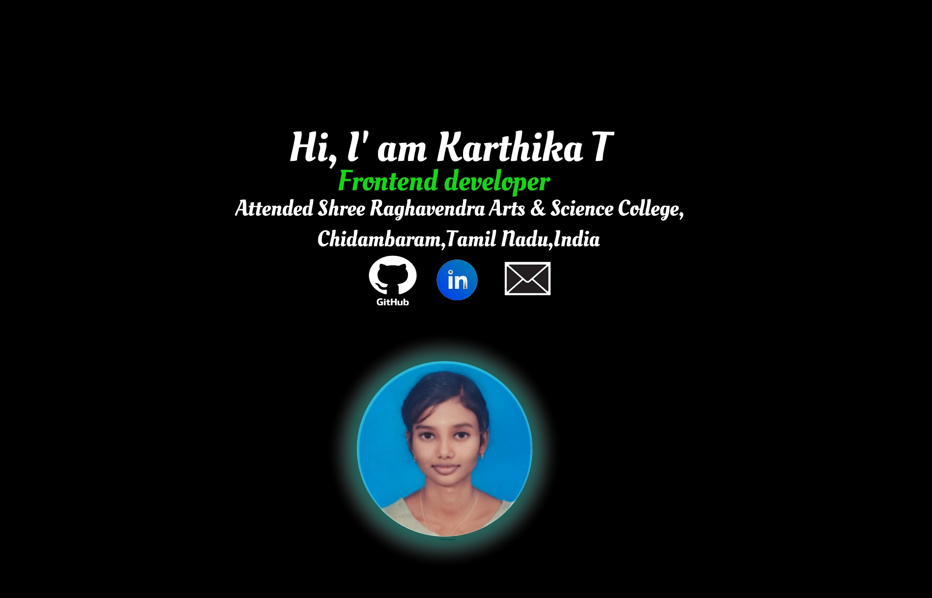

RESULTS AND SCREENSHOTS
3/21/2024 Annual Review
‹#›

Slide 12
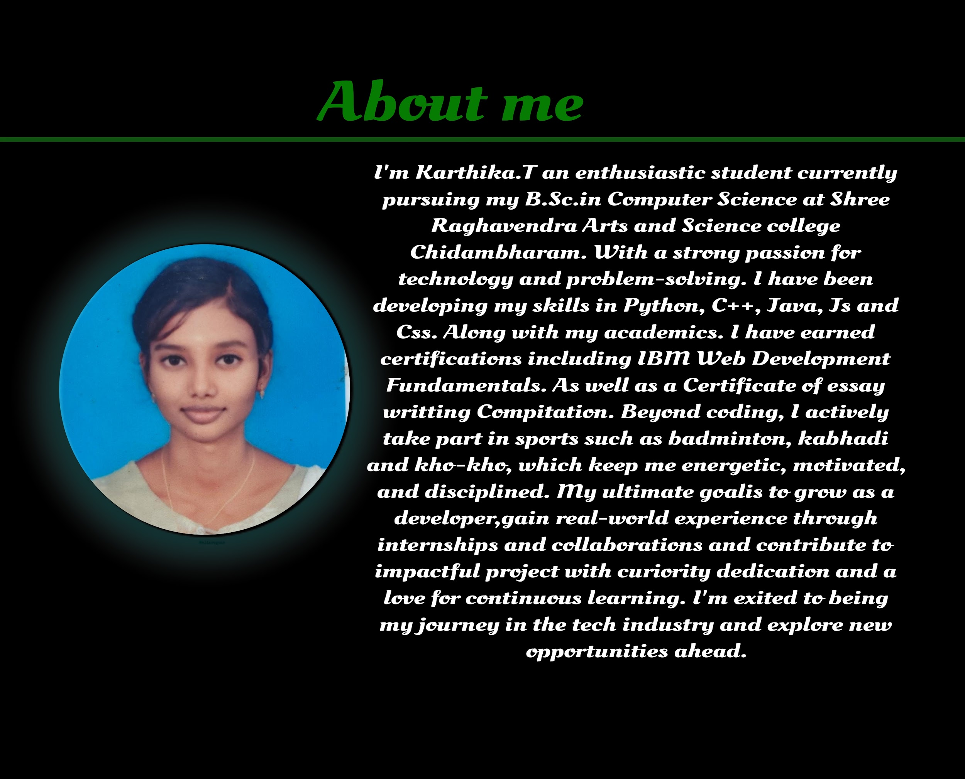
RESULTS AND SCREENSHOTS

Slide 13
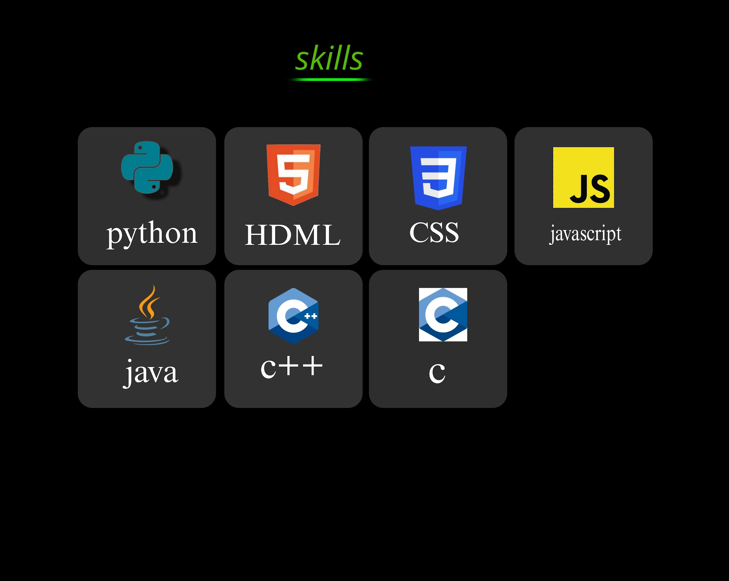
RESULTS AND SCREENSHOTS

Slide 14
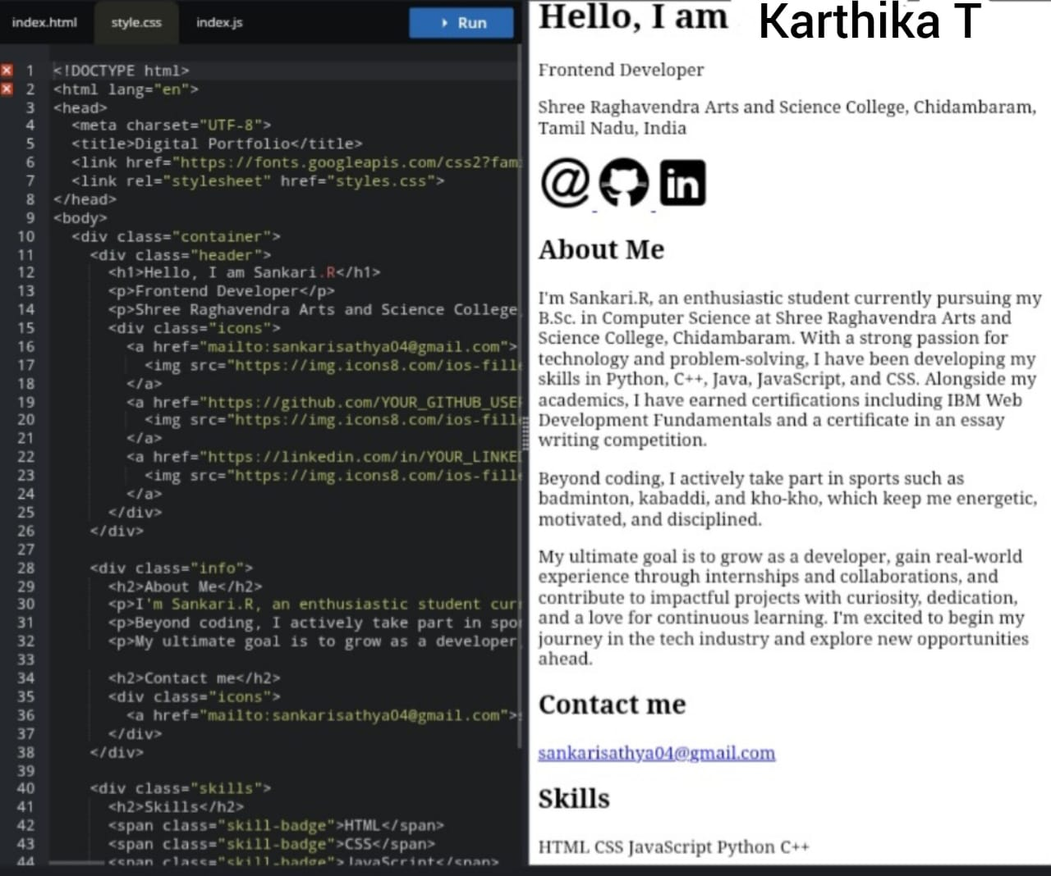
RESULTS AND SCREENSHOTS(CSS)

Slide 15
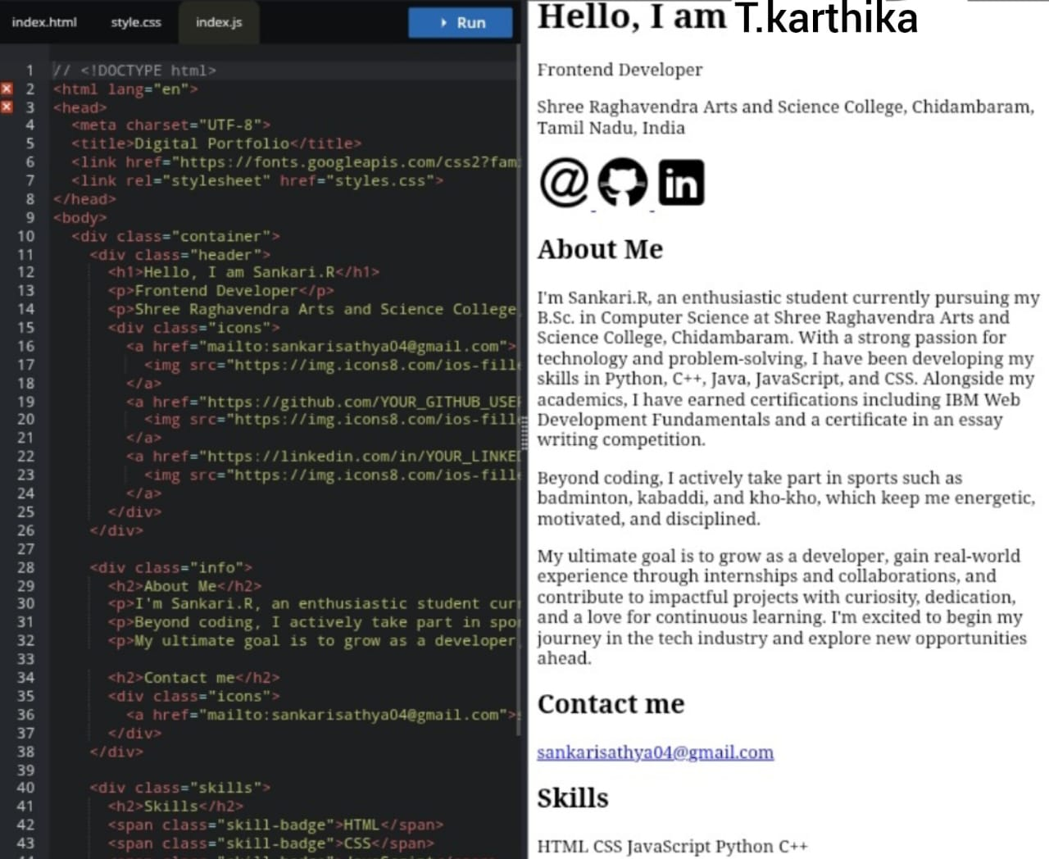
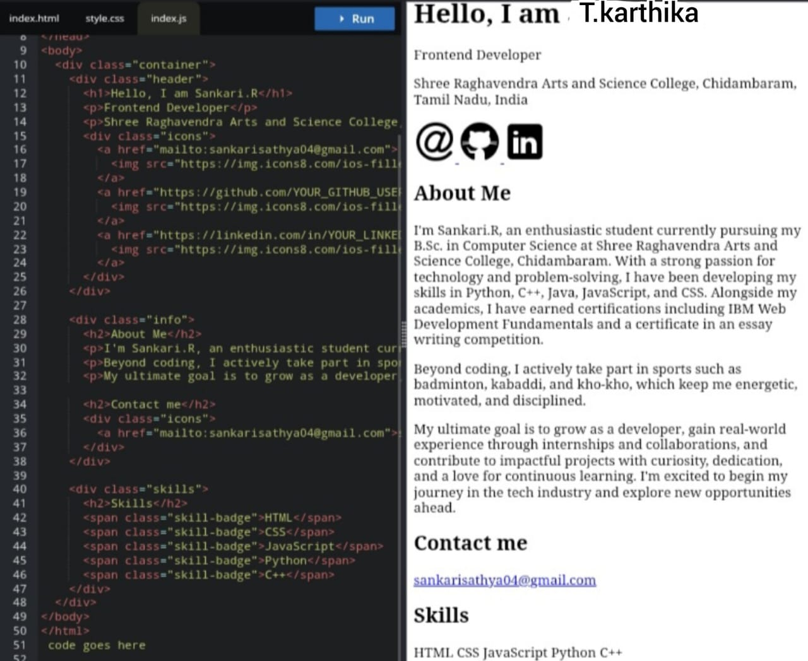
RESULTS AND SCREENSHOTS(JS)

Slide 16
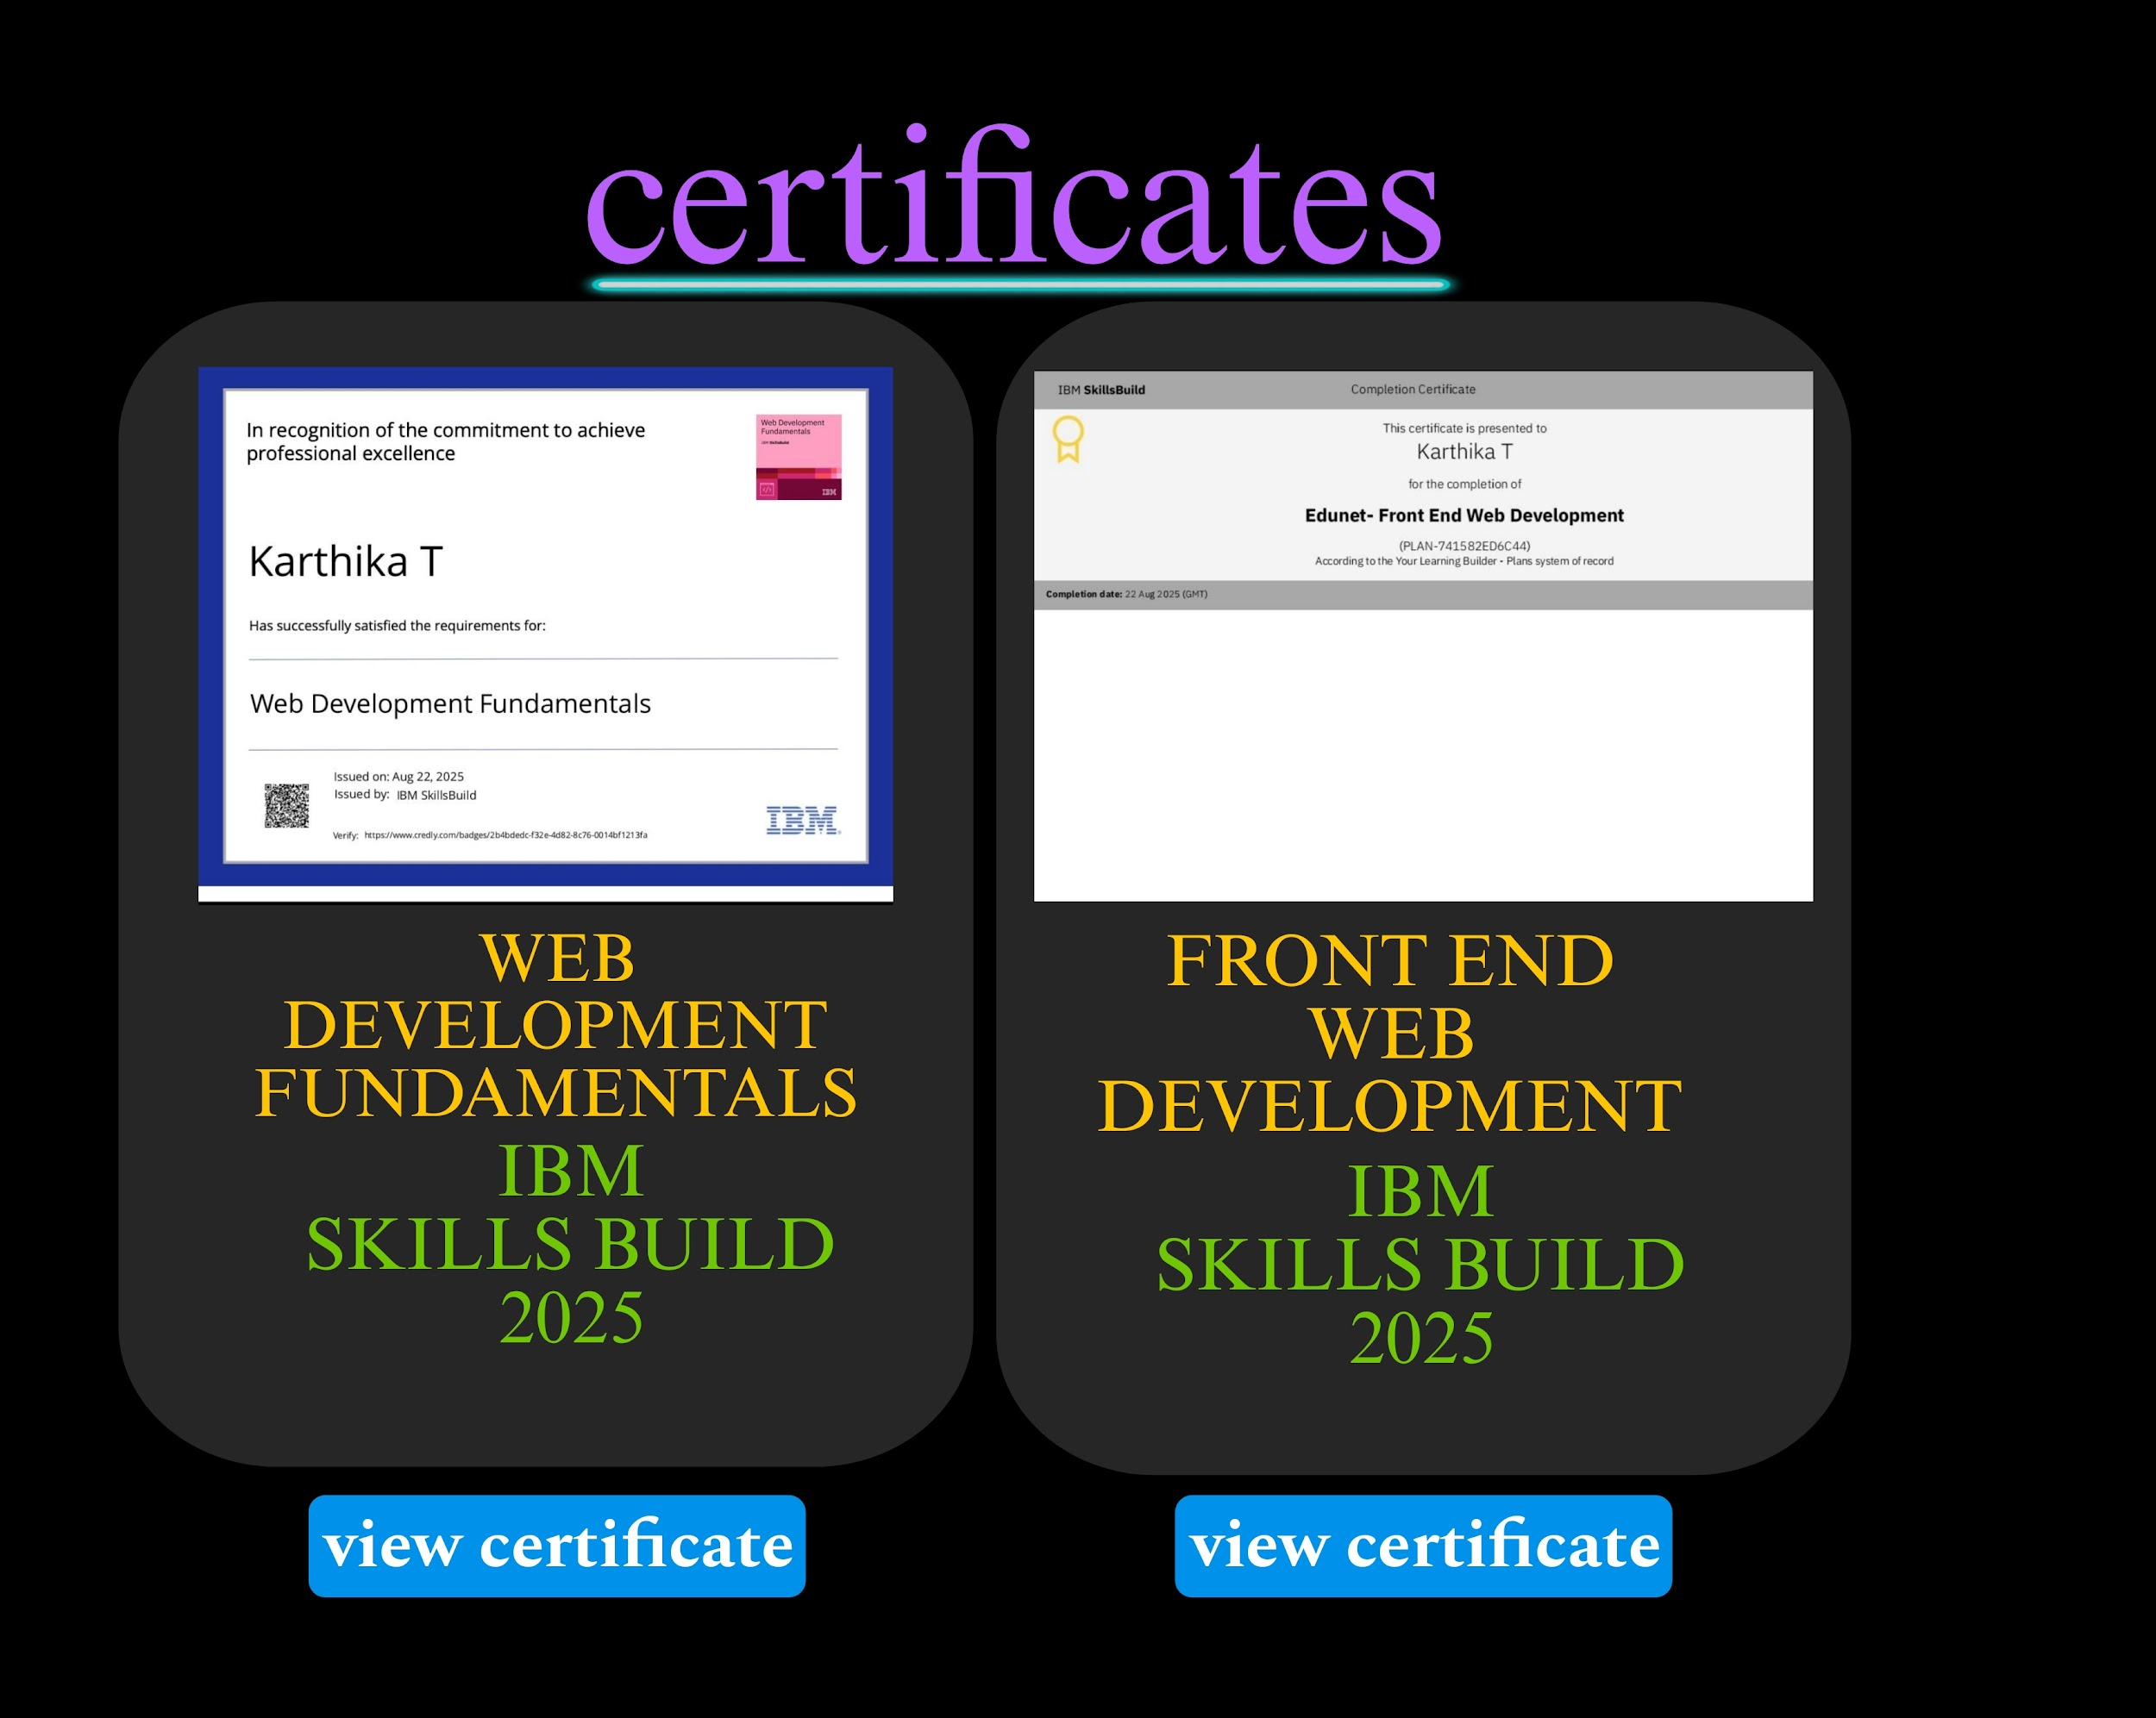
RESULTS AND SCREENSHOTS

Slide 17
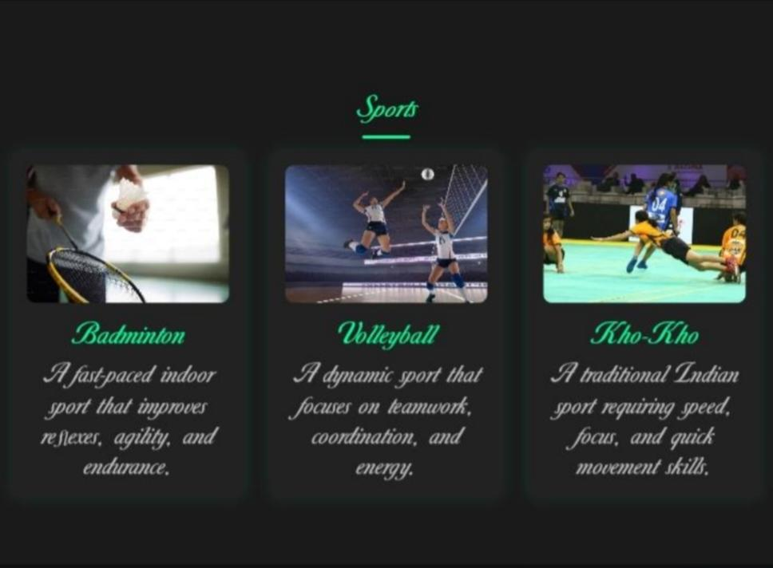
RESULTS AND SCREENSHOTS

Slide 18
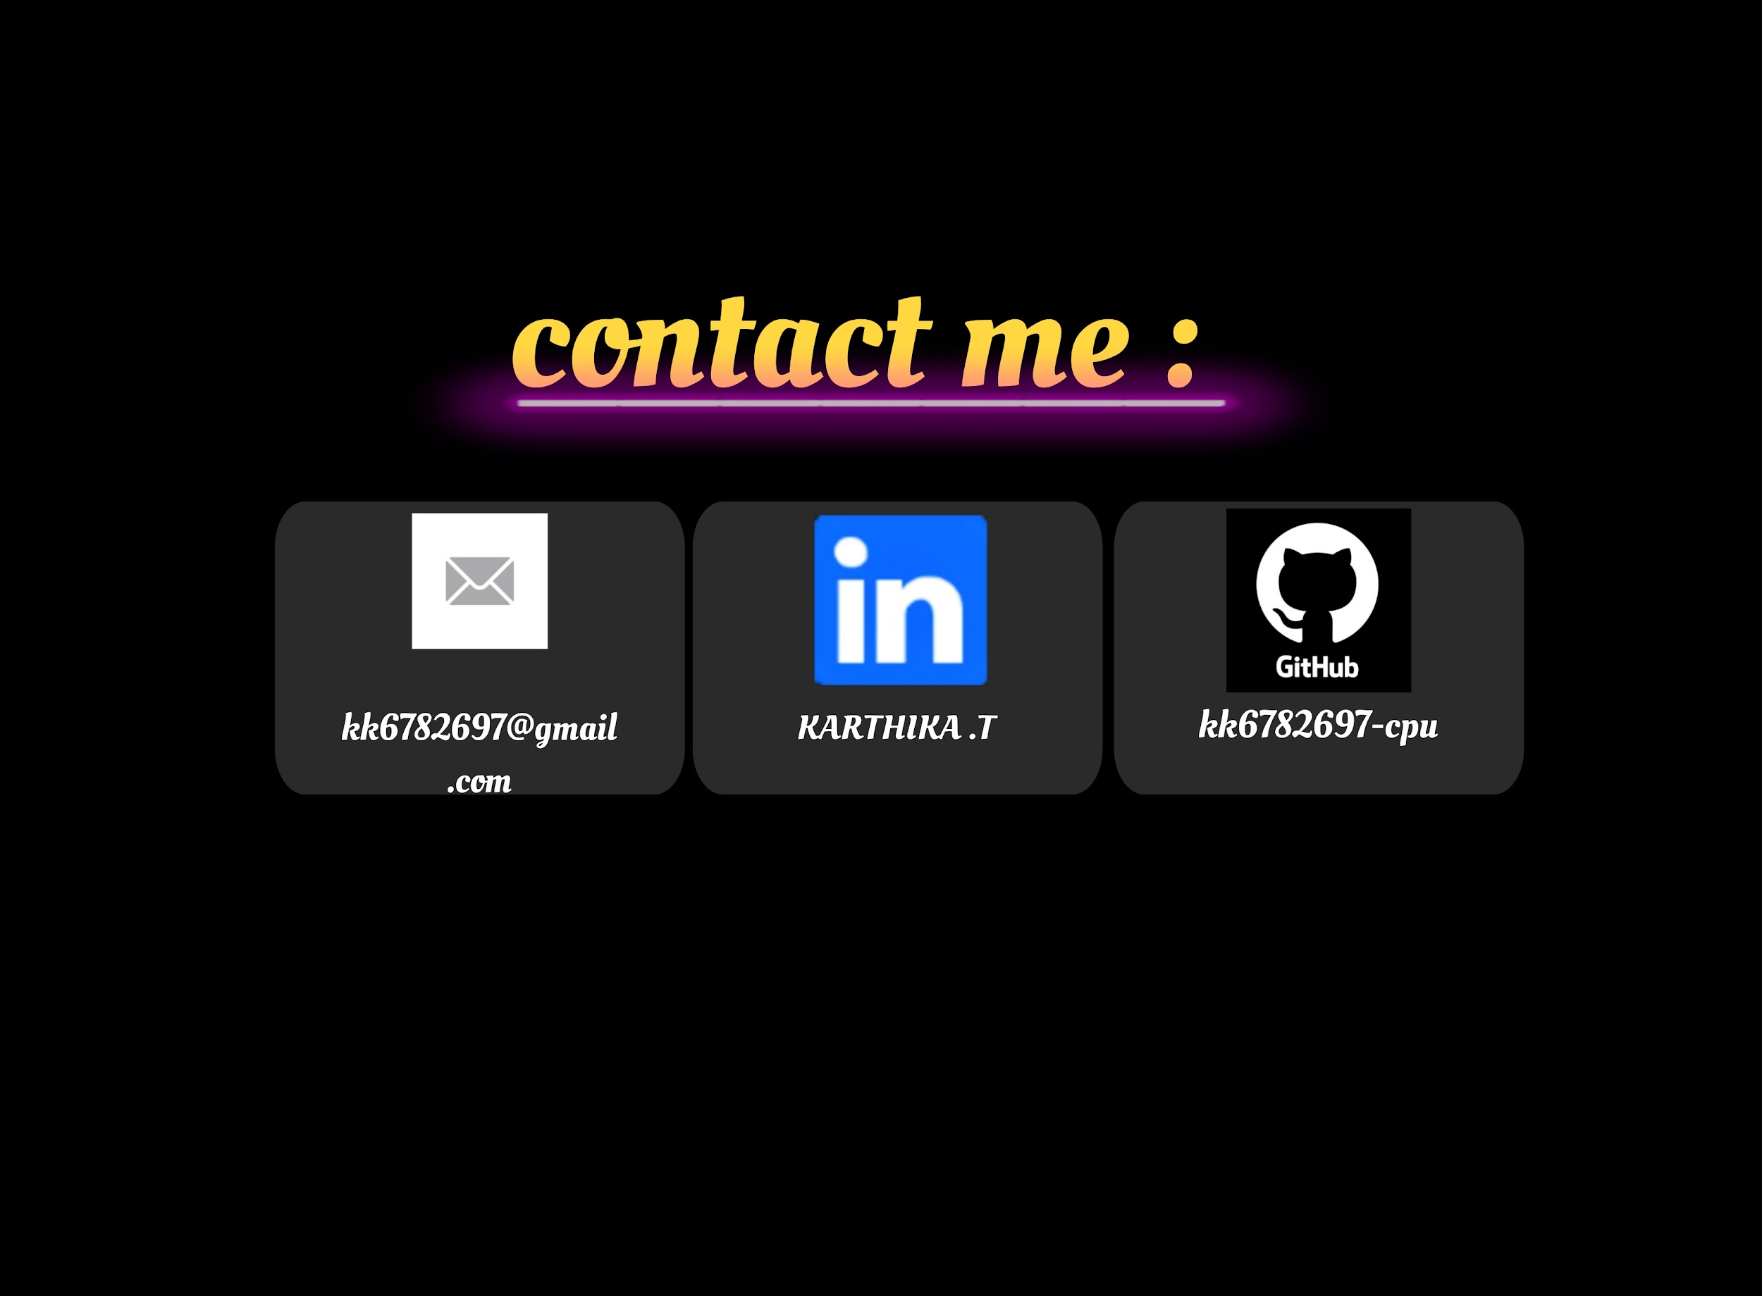
RESULTS AND SCREENSHOTS

Slide 19
CONCLUSION
The project demonstrates how a student can transform a static resume into a dynamic portfolio website. It serves as a platform to showcase technical skills, achievements, and extracurricular activities in a modern, interactive format. This portfolio will help Karthika in her academic growth, internships, and job opportunities.
‹#›

Slide 20
GITHUB LINK :
https://github.com/kk6782697-cpu

